Slide 1
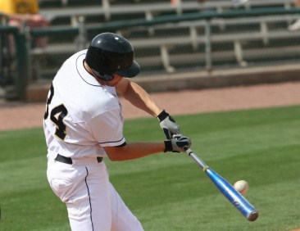
ENERGY
St. 13- Types of Energy
St. 14- Conservation of Energy

Slide 2
What is Energy?
Energy is the capacity of a system to do WORK
Unit for energy is a Joule
Energy exists in several forms, such as:
heat (thermal)
mechanical
kinetic / potential
light
electrical
Where does the energy come from that powers this ipod?

Slide 3
Types of energy
Mechanical Energy- motion and stored energy
Heat energy- internal motion of particles
Chemical energy- atom bonds break
Light or electromagnetic energy- moving electrical charges
5. Nuclear- fusing of nuclei

Slide 4
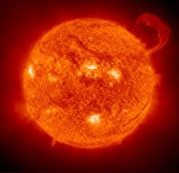
What type of energy?

Slide 5
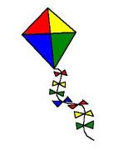
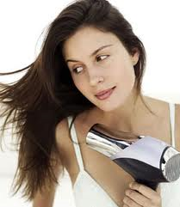
What type of energy?

Slide 6
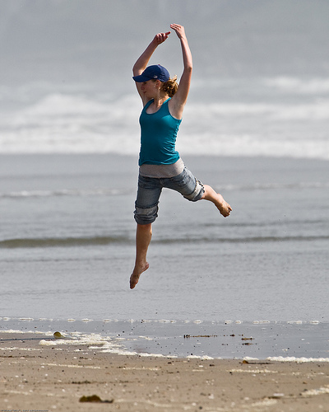
KINETIC ENERGY = the energy a moving object has because of its motion; it depends on the object's mass and speed
KE (joules) = 1/2 mass (kg) x speed (m/s)2
So.......
The kinetic energy will increase if
___ velocity increases ?
___ mass increases?
___ height increases?

Slide 7
Practice Problems
1. A jogger with a mass of 60 kg is moving at 2 m/s. What is the jogger's kinetic energy?
2. A ball with a mass of .2 kg is moving at a speed of 40 m/s. What is the balls kinetic energy?
3. A cart has a mass of 50 kg and a kinetic energy of 2000 J. What is the cart's speed?

Slide 8
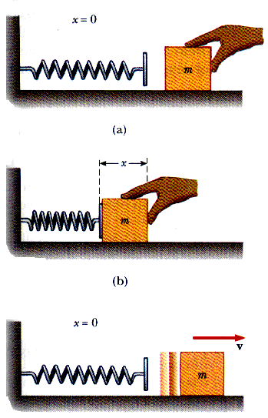
POTENTIAL ENERGY = energy stored within a motionless object
Stored energy has the potential to give energy back by doing work

Slide 9
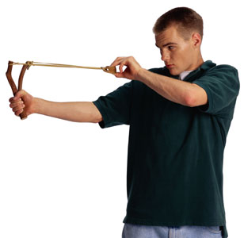
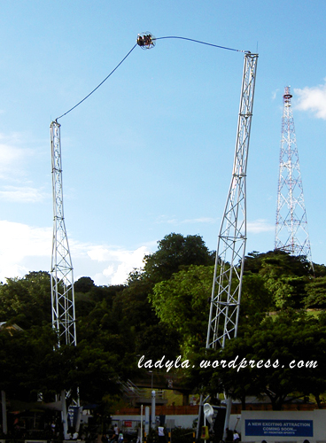
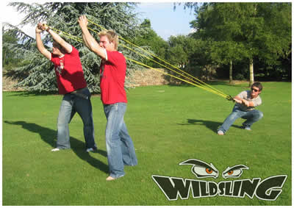
ELASTIC POTENTIAL ENERGY

Slide 10
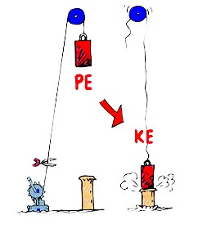
Gravitational Potential Energy = anything that can fall
GPE (Joules) =
mass (kg)
x
acceleration of gravity (9.8 m/s2)
x
height (m)
GPE = mgh

Slide 11
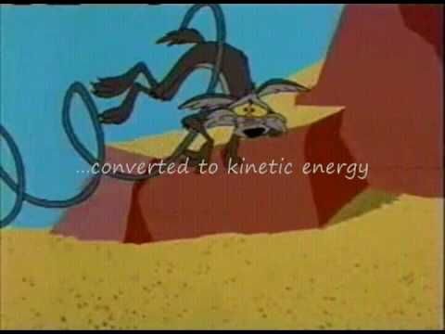

Slide 12
GPE = mgh
1. What is the GPE of a book that has a mass of 1kg that is sitting on a shelf that is 2 m above the ground?
2. How high above the ground is a ball with a mass of 2 kg that has a GPE of 70 J?
3. A rock climber is 200 m above the ground and has a GPE of 110,500 J. What is the climber's mass?

Slide 13
Think about it....
Can an object have kinetic energy and potential energy at the same time?
Two objects are sitting on a table. One has a mass of 5kg, the other has a mass of 2 kg. Which one has a greater GPE?
How could you increase the kinetic energy of a truck without increasing its speed?

Slide 14
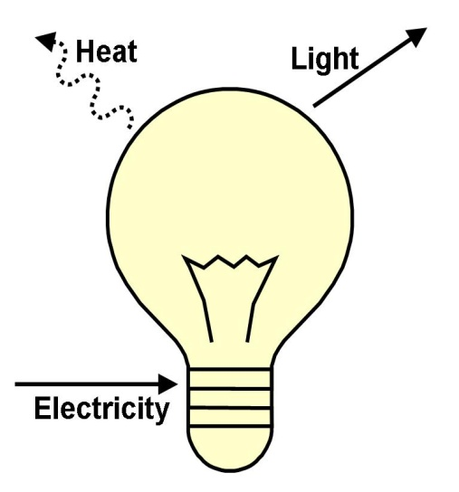
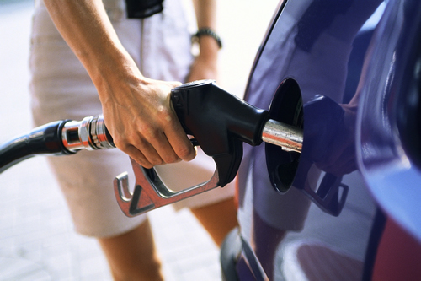
Energy can be converted from one form to another
Light bulbs transform electrical energy into light energy
Light bulbs feel warm because some of the energy is transformed into thermal energy
Chemical energy stored in gasoline is converted to kinetic (movement) energy and thermal (heat) energy.
Plants convert light energy into chemical energy (photosynthesis)

Slide 15
What energy conversion is taking place?
Battery powered radio
Chemical (battery) is converted into electrical. The electrical energy is converted into sound or mechanical energy

Slide 16
What energy conversion are taking place in a microphone-loudspeaker system?
Mechanical to electrical. The electromagnetic energy goes to the loudspeaker and then converts back into sound

Slide 17
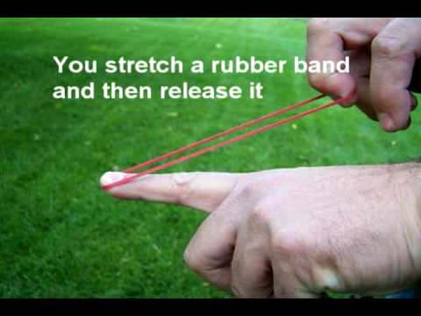

Slide 18
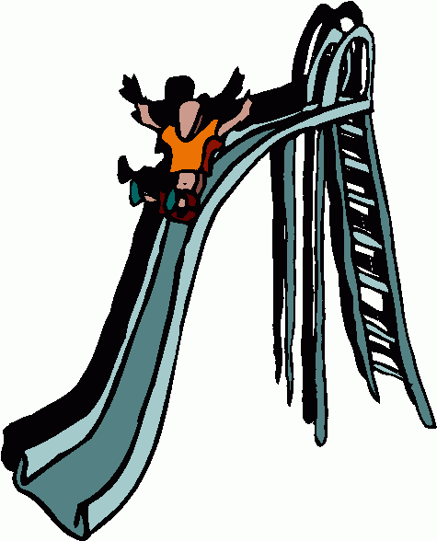
Mechanical Energy = Potential Energy + Kinetic Energy
Mechanical Energy is the energy due to position and motion
Potential energy can be transformed into mechanical energy....imagine a kid at the top of a slide... he has potential energy at the top. As he moves, he has kinetic and potential energy.

Slide 19
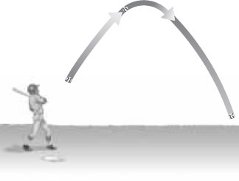
Low KE
High GPE
High KE
Low GPE
High KE
Low GPE
Energy transformations occur with projectile motion

Slide 20
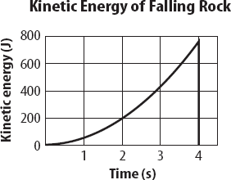
1. At what time was the rock's kinetic energy the greatest? ___
2. How much kinetic energy did the rock have at 3 s ? ____
3. What was the rock's potential energy before it fell? ____

Slide 21
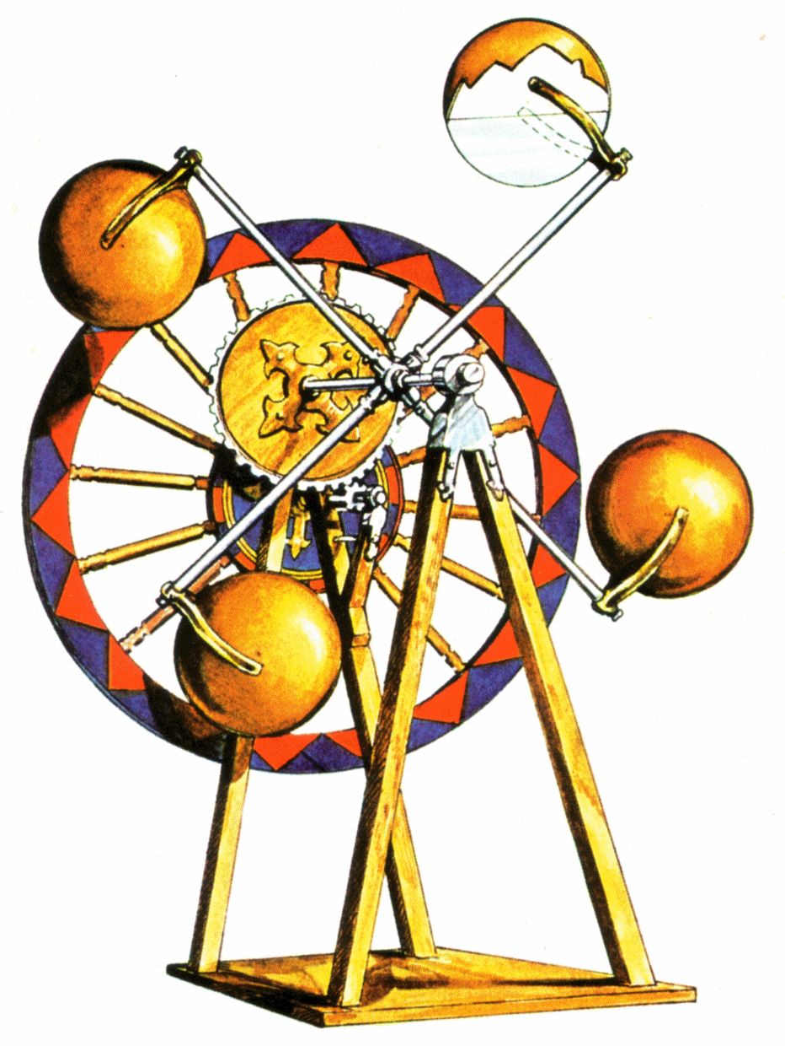
Law of Conservation of Energy = energy can change from one form to another, the total amount of energy never changes.
* simply, energy cannot be created or destroyed.
davinci's perpetual motion machine, arthur's clipart

Slide 22
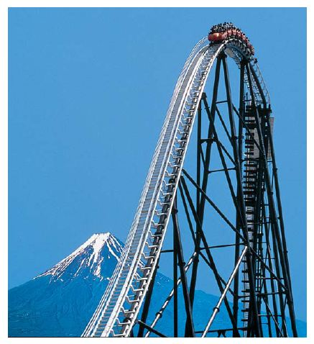
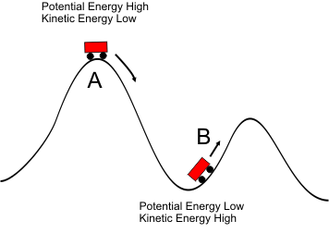
Roller coasters are designed with the Law of Conservation of Energy in Mind.

Slide 23
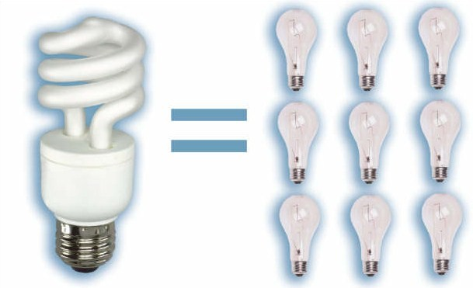
Friction and Air resistance
In almost all machines and activities some energy is converted to HEAT due to the affects of friction and air resistance.
When you slide down a slide you will eventually come to a stop, and you might even feel the seat of your pants warming up.
The more EFFICIENT your system runs, the smaller the amount of energy is converted to heat. New light bulbs don't get as hot and do not use as much energy.

Slide 24
1. What is the equation for KINETIC ENERGY?
2. What is the equation for GRAVITATIONAL POTENTIAL ENERGY?
3. According to this Law, energy is never created or destroyed. (Name the complete Law)
4. The type of energy stored in a stretched rubber band is _______________ energy.
5. The type of energy stored in the bonds of molecules is _________________ energy.
6. Energy of movement is called __________ energy.

